Slide 1
Survival Modeling
Alexander Baker

Slide 2

What is Survival?
The main purpose of survival is to analyze and model the time an entity spends within a system before a particular event occurs
Survival provides insights to the number of incidents that occur within a given period of time, and the probability of an incident occurring given a particular amount of time within the system
Generally speaking, the basis of survival modeling includes the techniques:
Survival Curves
Hazard Functions

Slide 3
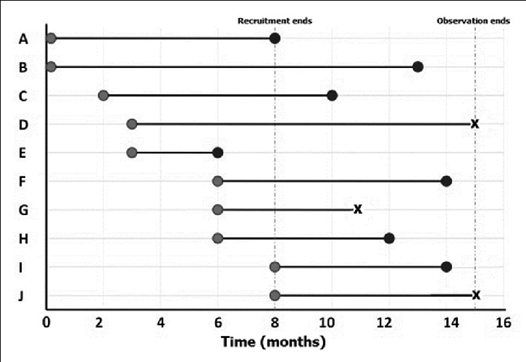
Basic Survival Concepts
Define the system, the observation period, what the event is, and what the entry point is
Make sure you select the appropriate number of discrete time units (i.e. seconds, minutes, days, etc.)
The timeline is defined as the number of discrete time units from the point of entry to the event occurrence, or end of the defined period
The start of the observation period is considered a the first date of the set, or set point in which an entity enters the system (i.e. date hired)
The end of the observation period is represented by the latest date within the dataset, or a chosen final cutoff (i.e. most recent date in the dataset)
The event is occurrence that removes an entity out of the system (i.e. employee attrition)
If an entity reaches the end of the period without experiencing an event occurrence, then that entity is considered censored since it is unknown when the event will occur in the future

Slide 4
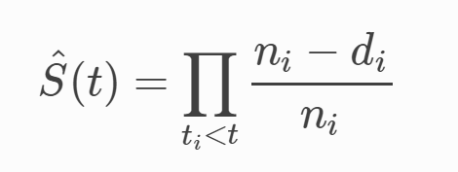
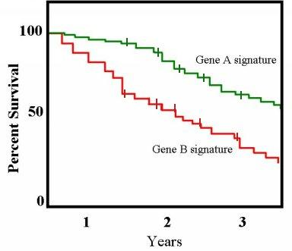
Survival Curve
Kaplan Meier is a method of fitting a survival curve based on time and the proportion of unaffected individuals over the total number of at risk individuals
The curve will fall based on the number of unaffected entities over the number at risk, multiplied by all the previous fall
If an entity is censored, the curve does not fall, but the number of at risk entities will decrease due to these entities not being present in the system

Slide 5
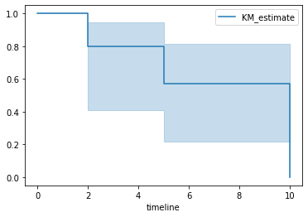
Survival Curve Example
The Kaplan Meier curve will start at time t=0
There are 10 cells at the start of the experiment
At time = 2, 2 of the cells died off, a point will be at time 2 at proportion (10-2)/10 = 0.8
At t = 3, 1 cell is censored
At t = 5, 2 cells died off, a point a proportion will be calculated, (7-2)/7 = 0.714, this is then multiplied by the previous drop, 0.714*0.8 = 0.57
At t = 7 2 cells are censored
At t = 10 3 cells drop off (3-3)/3 = 0, multiplied by the previous drop off ratios 0*0.714*0.8 = 0

Slide 6
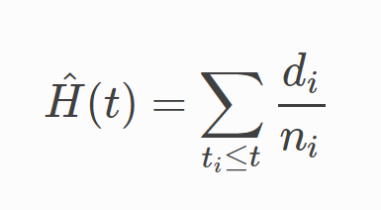
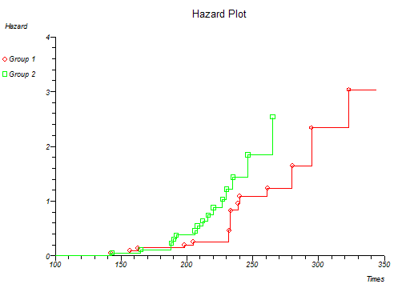
Hazard Curve
Nelson Aalen is a method that creates a hazard curve by calculating increases at certain times based on the number of events over the number of at risk entities
At each point the number of events over the number of at risk individuals are calculated
A jump is then calculated by taking this ratio and adding it to the previous jump
If an entity is censored, a jump will not be seen in the the curve, but the number of at risk entities will decrease

Slide 7
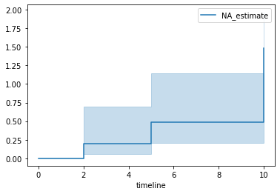
Nelson Aalen Example
Our hazard will start at 0
At time t = 2, 2 cells die, our hazard ratio will increase by 2/10 = 0.2
At time t=3, 1 cell is censored
At time t = 5, 2 cells die, the new hazard ratio is 2/7 = 0.28, this is added to the previous hazard ratio, 0.2+0.28 = 0.48
At time t = 7, 2 cells are censored
At time t = 10, 3 cells die off, 3/3 =1, this will be added to the previous hazard ratios 1+0.2+0.28 = 1.48

Slide 8
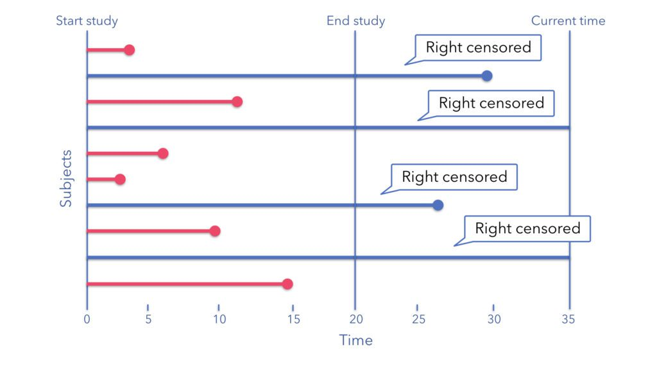
Censoring
In a survival analysis, the defined event can happen to all individuals
However there will be individuals that the event will not happen by the end of the observation period
As a result, it is unknown when the event will occur to this individuals
This uncertainty of event occurrence is known as censoring and requires survival methods to be accounted for when performing analysis or modeling

Slide 9
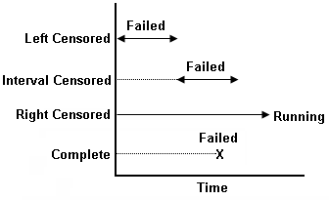
Left, Right, and Interval Censoring
Censoring occurs when an event is unknown given the period in which the survival analysis occurs
Left censoring is when the event occurred to an entity before the selected observation period
Right censoring is when the event of interest has not occurred to a particular entity by the end of the selected observation period
Interval censoring is when the exact time of the event is unknown, but the event is known to occur within a specific period of time

Slide 10
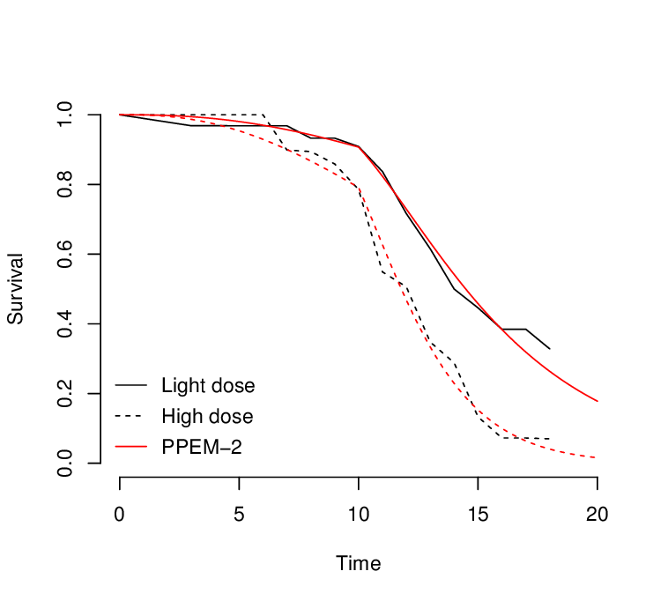
Handling Censored Data
Left censored can be handled by dropping them (since they can be considered to be included as a part of a different analysis), or extending the observation period to include the event’s entry and exit into the system
Right censored data is handled by incorporating the overall event occurrence as part of the model output
Interval censored can be handled using approximators like the Turnbull approximator
One can also make survival curves based on the upper, lower, and mid-point to perform the analysis with
If the entry point is unknown, it can be replaced with the start of the period with a covariate indicating that it’s not exact

Slide 11
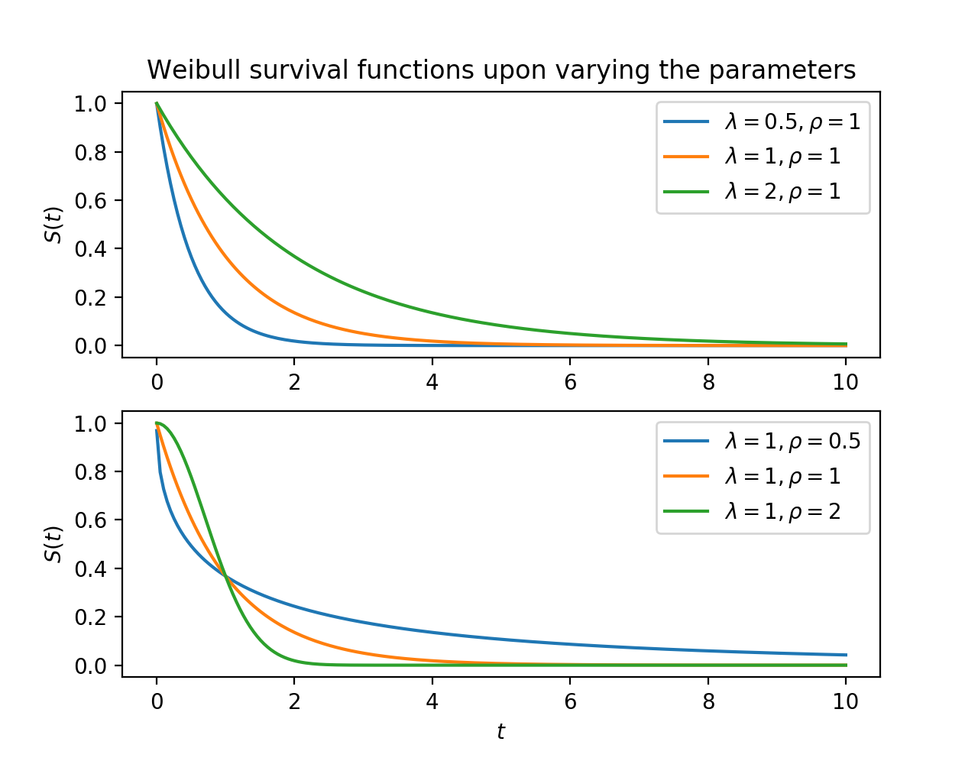
Parametric models
The survival and hazard curves can create a group of points that a parametric model can be fit to
These can be fit through numerous means such as minimizing MAE, using goodness of fit methods, etc.
Some of the parametric survival models include:
Exponential curve fitting
Weibull curve fitting
Lognormal fitting
Generalized Gamma fitter
These fitted curves allow for survival probability extrapolation
This allows for the extrapolation of survival models(KM, and NA models extrapolate by just taking the final value of the curve)

Slide 12
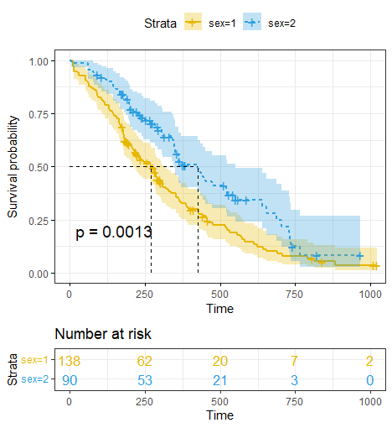
Comparing Survival Curves
Two survival curves can be compared using the Log Rank Test
The null is that there is no differences
The alternative hypothesis is that there is a difference
This is a modified chi squared statistic using the observed, expected and variances derived using the values from the two survival curves
Log rank is also an important building block within numerous survival models, and can provide us a method of quantifying the difference between two survival curves

Slide 13
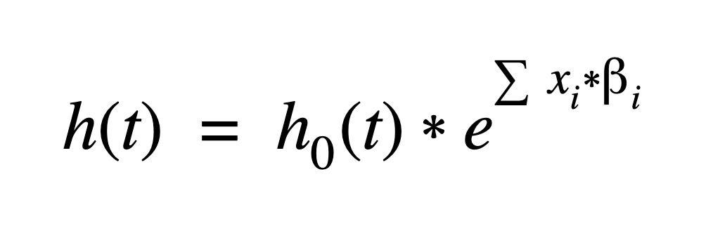
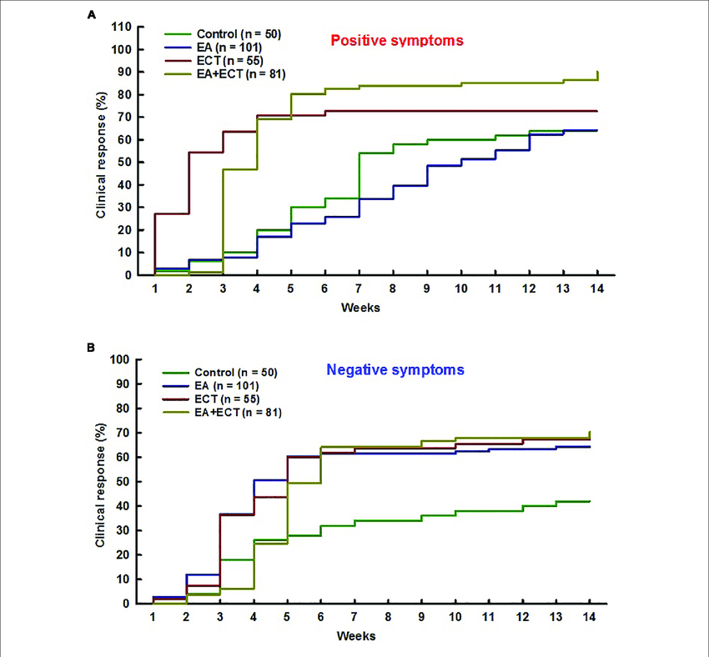
Cox Proportional Hazard
The CoxPH model is a method of creating hazard and survival curves incorporating the influence of other variables
The base hazard curve incorporates only the times and events
This hazard function is multiplied by the exponential of each coefficient multiplied by the relevant covariate values (attributes for a specific entity)
This creates unique survival curves based on the set of attributes for each entity within the dataset
This is called the proportional hazard model because the exponential of the exponent reveals the hazard ratio for the feature

Slide 14
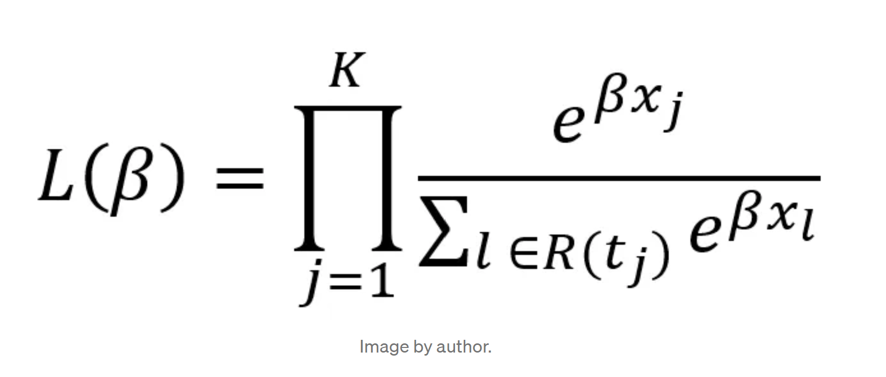
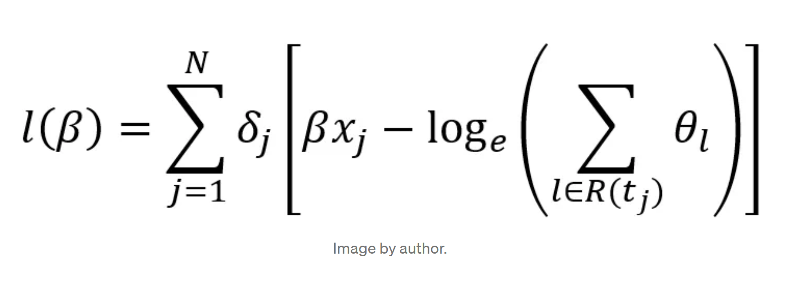
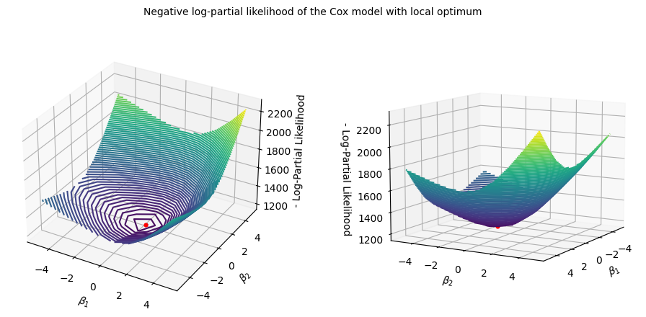
Fitting the CoxPH Model
Coefficients are found by minimizing the negative log partial likelihood
We want to maximize the chance of saying an event occurs at a given time given that it does
This is known as the partial likelihood, is converted to the log partial likelihood function and converted to the loss function called the negative log likelihood
The negative log likelihood function has a global minimum used to find the optimal parameters

Slide 15
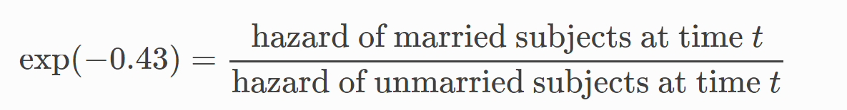
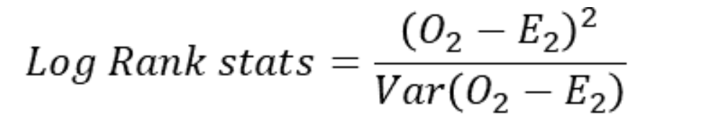
Analysis
The summary of the CoxPH model can provide numerous insights on survival data
This summary can include:
The coefficients: how certain covariates influence the hazard and survival curves
The hazard ratios: the comparison of the instantaneous hazard rate of the base survival curve and the covariate affected curve
Below 1 indicates a decrease in risk, above 1 is an increase in risk, at 1 indicates a lack of association
The survival curve statistical test: a statistic, and p value from a test that quantifies the difference between a base survival curve and the covariate affected survival curve

Slide 16
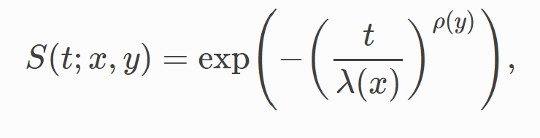
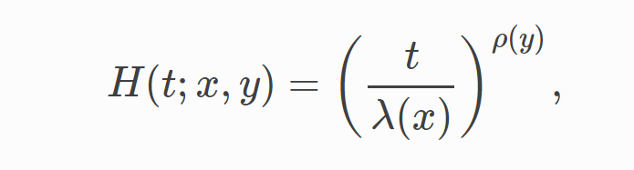
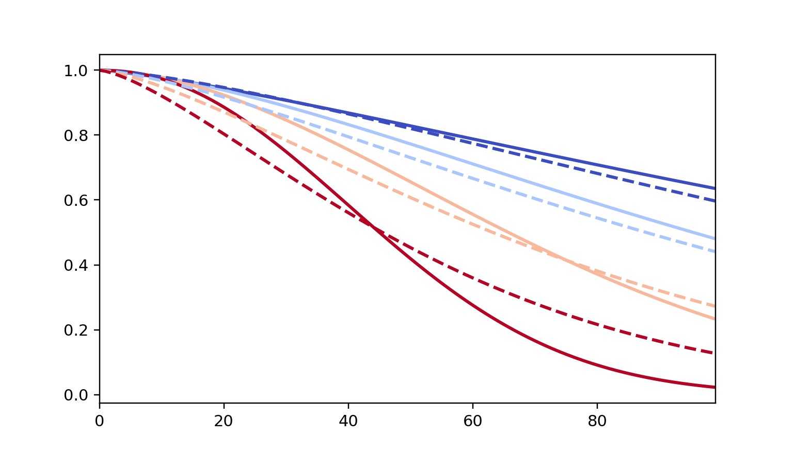
AFT Fitters
AFT stands for accelerated failure time models
The term accelerated comes from the coefficients and covariates either accelerating or decelerating the failure rates of parametric models
These essentially take a parametric model implement covariates within the equation to create unique failure distributions for each entity within the dataset
These equations can differ depending on the chosen parametric model
The parametric models previously reviewed have an AFT counterpart
These can be used for extrapolation of the covariate influenced survival curves

Slide 17

Conclusion
The realm of survival consists of modeling and analyzing the time an entity spends within a system before a particular event occurs
The hazard functions are based on the proportion of incidents over the at risk individuals at a particular moment in time within a chosen observation period
The survival curve demonstrates the proportion of unaffected entities at a particular moment in time
Parametric curve can to these hazards or survival data for the purpose of extrapolation
CoxPH and AFT fitters include the effect of covariates within survival models that create unique survival curves for each entity

Slide 18
Next Steps
Survival Trees
Survival Forest
Survival Vector Machines
Deep Learning

